Slide 1

Handling Java Exceptions - Spring Way
Azat Satklichov
azats@seznam.cz,
http://sahet.net/htm/java.html,
https://github.com/azatsatklichov/vatinfo
Notes:
JSLint can be found at http://www.JSLint.com/.
JavaScript statements are composed of: Values, Operators, Expressions, Keywords, and Comments.
JavaScript programs (and JavaScript statements) are often called JavaScript code.
var x, y, z; // Statement 1 x = 5; // Statement 2 y = 6; // Statement 3
var x = 5 * 10; //Statement 4
JavaScript uses the var keyword to declare variables.
An expression is a combination of values, variables, and operators, which computes to a value. E.g. 5 * 10 or x * 10
JavaScript variables are containers for storing data values.
All JavaScript variables must be identified with unique names. JavaScript identifiers are case-sensitive.
Creating a variable in JavaScript is called "declaring" a variable.
var carName;
Difference Between Unicode and UTF-8: Unicode is a character set. UTF-8 is encoding.
Unicode is a list of characters with unique decimal numbers (code points). A = 65, B = 66, C = 67, ....
This list of decimal numbers represent the string “ahello": 97 104 101 108 108 111
Encoding is how these numbers are translated into binary numbers to be stored in a computer:
UTF-8 encoding will store "hello" like this (binary): 01101000 01100101 01101100 01101100 01101111
Encoding translates numbers into binary . Character sets translates characters to numbers.

Slide 2
Agenda
Java Exceptions
HTTP Request Methods, Response Status Codes
Handling exceptions in Spring Framework
Mapping exceptions to HTTP status code
Writing exception-handling methods
Adwising Controllers - @ControllerAdvice
References
Notes:
https://developer.mozilla.org/en-US/docs/Web/HTTP/Caching
https://www.restapitutorial.com/httpstatuscodes.html
https://www.tutorialspoint.com/http/http_caching.htm
https://www.baeldung.com/java-exceptions
http://tutorials.jenkov.com/java-exception-handling/checked-or-unchecked-exceptions.html
We usually write code in an idealized environment: the filesystem always contains our files, the network is healthy, and the JVM always has enough memory. Sometimes we call this the “happy path”.

Slide 3
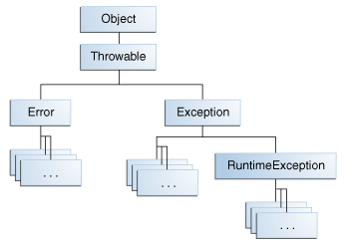

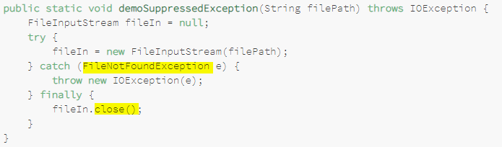
Java Exceptions
Checked exceptions - exceptional conditions should anticipate and recover from, and
subject to (compiler forces) Handle or Declare(Specify) [*]. E.g. Path (wrong-file-name)
Unchecked exceptions (Errors, Runtime Exceptions) are not subject to [*])
Errors - external to the app., recovery not possible. E.g. Hardware issue
Runtime exception - internal to the app., recovery not possible. E.g. Program err.
Enhanced Features:
Java 7: try-with-resource (AutoCloseable),
multi-catch examples, Suppressed,
Java 9: Thread’s |Throwables’s getStackTrace(),[] was costly so new lazy-access to stack-trace java.lang.StackWalker
Java 10 (try (var fis = new FileInputStream("abc.txt"))
Suppressed Exceptions - demoSuppressException method throws the exception thrown from the finally block; the exception thrown from the catch block (or even in try block) is suppressed.
Use Java 7 Throwable addSuppressed and getSuppressed methods to get lost exceptions
Or use try-with-resource Java approach, then you see original Exception will be thrown
Or safe code – validation check
Notes:
https://howtodoinjava.com/java9/java9-new-features-enhancements/#stack-walking
defines an efficient standard API for stack walking that allows the easy filtering of and lazy access to stack trace information.
This API supports short walks that stop at a stack frame matching given criteria, and also supports long walks that traverse the entire stack.
Finally block - always executed and for preventing resource leaks (does cleanup accidentally bypassed by return, continue, or break). Good practice is Not use RETURN in finally.
Now that we have seen the difference in code between checked and unchecked exceptions, let's dive into the arguments for and against both.
Some Java books(*) covering exceptions advice you to use checked exceptions for all errors the application can recover from, and unchecked exceptions for the
errors the application cannot recover from.
In reality most applications will have to recover from pretty much all exceptions including NullPointerException, IllegalArgumentExceptions and many other unchecked exceptions. The action / transaction that failed will be aborted but the application has to stay alive and be ready to serve the next action / transaction. The only time it is normally legal to shut down an application is during startup. For instance, if a configuration file is missing and the application cannot do anything sensible without it, then it is legal to shut down the application.
The Three Kinds of Exceptions
The first kind of exception is the checked exception. These are exceptional conditions that a well-written application should anticipate and recover from. For example, suppose an application prompts a user for an input file name, then opens the file by passing the name to the constructor for java.io.FileReader. Normally, the user provides the name of an existing, readable file, so the construction of the FileReader object succeeds, and the execution of the application proceeds normally. But sometimes the user supplies the name of a nonexistent file, and the constructor throws java.io.FileNotFoundException. A well-written program will catch this exception and notify the user of the mistake, possibly prompting for a corrected file name.
Checked exceptions are subject to the Catch or Specify Requirement. All exceptions are checked exceptions, except for those indicated by Error, RuntimeException, and their subclasses.
The second kind of exception is the error. These are exceptional conditions that are external to the application, and that the application usually cannot anticipate or recover from. For example, suppose that an application successfully opens a file for input, but is unable to read the file because of a hardware or system malfunction. The unsuccessful read will throw java.io.IOError. An application might choose to catch this exception, in order to notify the user of the problem — but it also might make sense for the program to print a stack trace and exit.
Errors are not subject to the Catch or Specify Requirement. Errors are those exceptions indicated by Error and its subclasses.
The third kind of exception is the runtime exception. These are exceptional conditions that are internal to the application, and that the application usually cannot anticipate or recover from. These usually indicate programming bugs, such as logic errors or improper use of an API. For example, consider the application described previously that passes a file name to the constructor for FileReader. If a logic error causes a null to be passed to the constructor, the constructor will throw NullPointerException. The application can catch this exception, but it probably makes more sense to eliminate the bug that caused the exception to occur.
However, in this example, if the methods readLine and close both throw exceptions, then the method readFirstLineFromFileWithFinallyBlock throws the exception thrown from the finally block; the exception thrown from the try block is suppressed. Since Java SE 7 suppressed exceptions Throwable.getSuppressed method.
You can retrieve these suppressed exceptions by calling the Throwable.getSuppressed method from the exception thrown by the try block.
In this case, the try block will throw a FileNotFoundException when it tries to open the non-existent file. Because the fileIn object was never initialized, it'll throw a NullPointerException when we try to close it in our finally block. Our calling method will only get the NullPointerException, and it won't be readily obvious what the original problem was: that the file doesn't exist.

Slide 4
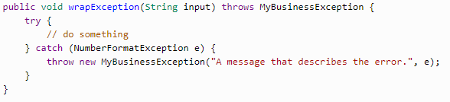
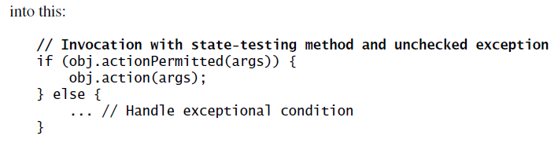
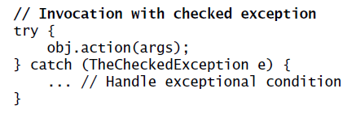
Unchecked Exceptions — The Controversy
Java programming language does not require methods to catch or to specify unchecked exceptions (compiler not forces)
Wrap the Exception Without Consuming it – your
Custom Exceptions to add additional business spec-info. E.g.
Contactless payment Provisioning err. Or Spring exceptions.
Avoid unnecessary use of Checked Exceptions
Checked exceptions can increase the reliability of programs [;) see swallowed exception] - when overused, they make APIs painful to use. Java 8, as methods throwing checked exceptions can’t be used directly in streams
- Instead of throwing a checked exception, the method simply returns an empty optional. (can’t return additional info)
- Turn Checked Exception into Unchecked
Antipatterns
- Swallowing Exceptions: try { // ... } catch (Exception e) {} // <== catch and swallow
Using return in a finally Block: see JavaDemoExceptionsAntipatterns and According to the Java Language Specification:
Using throw in a finally Block
Using throw as Go To
Log and Throw - try { // ... } catch (Exception e) { log.error(e); throw e}; //It will write multiple err-msg for same ex.
Not documenting Exceptiong in Java doc - @throws
Notes:
programmers may be tempted to write code that throws only unchecked exceptions or to make all their exception subclasses inherit from RuntimeException. Both of these shortcuts allow programmers to write code without bothering with compiler errors and without bothering to specify or to catch any exceptions.
Add a try/catch block to the lambda expression 2. Create an extracted method, as in the unchecked example 3. Write a wrapper method that catches checked exceptions and rethrows them as unchecked
http://tutorials.jenkov.com/java-exception-handling/exception-wrapping.html
Dealing with checked exceptions
The compiler requires you to prepare for checked exceptions, so simply ignoring the problem is no longer an option. Instead, you have three primary approaches:
1. Add a try/catch block to the lambda expression
2. Create an extracted method, as in the unchecked example
3. Write a wrapper method that catches checked exceptions and rethrows them as unchecked
Instead of throwing a checked exception, the
method simply returns an empty optional. The disadvantage of this technique is
that the method can’t return any additional information detailing its inability to
perform the desired computation. Exceptions, by contrast, have descriptive types,
and can export methods to provide additional information (Item 70).

Slide 5
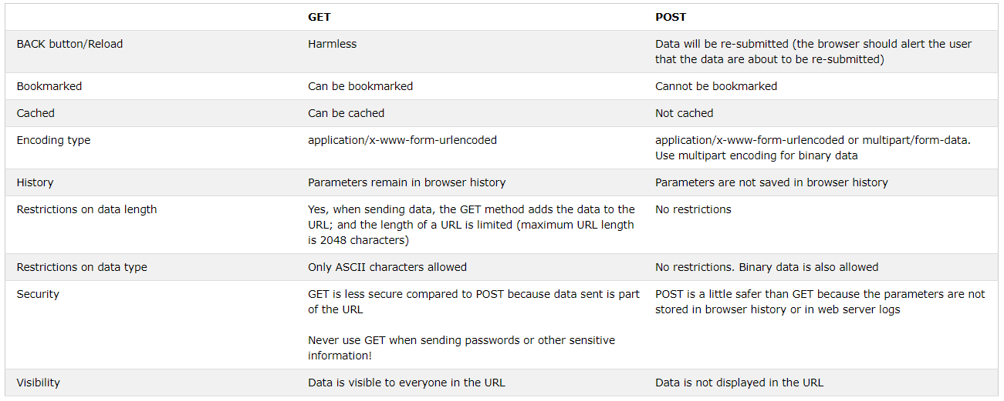
HTTP Request Methods
HTTP works as a request-response protocol between a client and server.
HTTP Methods: GET, POST, PUT, HEAD, DELETE, PATCH, CONNECT, OPTIONS, TRACE
Notes:
The HTTP TRACE method is designed for diagnostic purposes. If enabled, the web server will respond to requests that use the TRACE method by echoing in its response the exact request that was received.

Slide 6
HTTP Response Status Codes
https://www.w3schools.com/tags/ref_httpmessages.asp
When a browser requests a service from a web server, an error might occur, and the server might return an error code (status code) like "404 Not Found". Below is a list of HTTP status messages that might be returned. XX (00-99)
1xx: Information
100 Continue | 101 Switching Protocols | 102 Processing(WebDAV), 103 Checkpoint (early hints, Link Header)
2xx: Successful
200 OK (GET, HEAD, PUT, POST, TRACE) | 201 Created (POST, PUT) | 202 Accepted (noncommittal)
203 Non-Authoritative Information | 204 No Content | 205 Reset Content, …
300 Multiple Choices | 301 Moved Permanently | 302 Found
303 See Other (GET) | 304 Not Modified (forcaching) | 306 Switch Proxy, …
3xx: Redirection
400 Bad Request | 401 Unauthorized | 402 Payment Required (future)
403 Forbidden | 404 Not Found | 405 Method Not Allowed (security)
406 Not Acceptable | 415 Unsupported Media Type | …
4xx: Client Error
5xx: Server Error
500 Internal Server Error | 501 Not Implemented (Server must support GET, HEAD) | 502 Bad Gateway
503 Service Unavailable | 504 Gateway Timeout | 505 HTTP Version Not Supported
511 Network Authentication Required | …
Notes:
https://www.restapitutorial.com/httpstatuscodes.html
https://developer.mozilla.org/en-US/docs/Web/HTTP/Status
https://www.tutorialspoint.com/http/http_status_codes.htm
https://en.wikipedia.org/wiki/WebDAV
WebDAV is a long-standing protocol that enables a webserver to act as a fileserver and support collaborative authoring of content on the web. Though being supplanted by more modern mechanisms, it’s still a reliable workhorse encountered in many different servers, clients, and apps.
You might encounter WebDAV in the Apache HTTP Server, Microsoft IIS, Box.com, WordPress, Drupal, Microsoft Sharepoint, Subversion, Git, Windows Explorer, macOS Finder, Microsoft Office, Apple iWork, Adobe Photoshop, and many other places
Information responses
100 ContinueThis interim response indicates that everything so far is OK and that the client should continue the request, or ignore the response if the request is already finished.101 Switching ProtocolThis code is sent in response to an Upgrade request header from the client, and indicates the protocol the server is switching to. 102 Processing (WebDAV)This code indicates that the server has received and is processing the request, but o response is available yet.103 Early Hints This status code is primarily intended to be used with the Link header, letting the user agent start preloading resources while the server prepares a response.

Slide 7
Handling exceptions
No matter what happens (positive or negative output), the outcome of a servlet request is a servlet response !!!
Spring offers a handful of ways to translate exceptions to responses:
Certain Spring exceptions are automatically mapped to specific HTTP status codes.
An exception can be annotated with @ResponseStatus to map it to an HTTP status code.
A method can be annotated with @ExceptionHandler to handle the exception.
Notes:
Handling exceptions
Up to this point, we’ve been assuming that everything will always work in the Spittr
application. But what if something goes wrong? What if, while handling a request, an
exception is thrown? What response will be sent to the client when thing go awry?
No matter what happens, good or bad, the outcome of a servlet request is a servlet
response. If an exception occurs during request processing, the outcome is still a servlet
response. Somehow, the exception must be translated into a response.

Slide 8
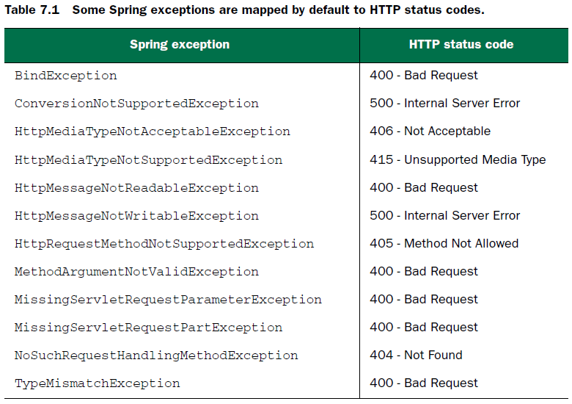

Mapping exceptions to HTTP status codes
Spring automatically (built-in) maps a dozen of its own exceptions (result of something going wrong in DispatcherServlet or while performing validation) to appropriate status codes.
Although these built-in mappings are helpful, they do no good for any application
exceptions that may be thrown.
public class RateNotFoundException extends RuntimeException {
public RateNotFoundException(String msg) {
super(msg);
}
How?
What if some engine processes your data and makes a decision based on your STATUS Code? E.g. games, rates, …
Notes:
The exceptions in table 7.1 are usually thrown by Spring itself as the result of something
going wrong in DispatcherServlet or while performing validation. For example,
if DispatcherServlet can’t find a controller method suitable to handle a request,
a NoSuchRequestHandlingMethodException will be thrown, resulting in a response
with a status code of 404 (Not Found).
Although these built-in mappings are helpful, they do no good for any application
exceptions that may be thrown. Fortunately, Spring offers a way to map exceptions to
HTTP status codes via the @ResponseStatus annotation.

Slide 9
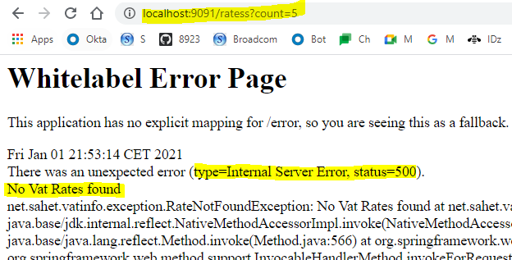
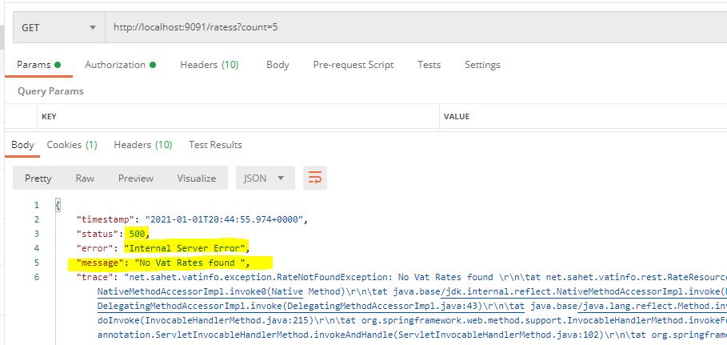
Mapping exceptions to HTTP status codes
E.g. You search item by ID or by some criteria, and data is not found, but you receive “Not FOUND”
error message with status code 500 ;( (Internal Server Error)
Notes:
The exceptions in table 7.1 are usually thrown by Spring itself as the result of something
going wrong in DispatcherServlet or while performing validation. For example,
if DispatcherServlet can’t find a controller method suitable to handle a request,
a NoSuchRequestHandlingMethodException will be thrown, resulting in a response
with a status code of 404 (Not Found).
Although these built-in mappings are helpful, they do no good for any application
exceptions that may be thrown. Fortunately, Spring offers a way to map exceptions to
HTTP status codes via the @ResponseStatus annotation.

Slide 10
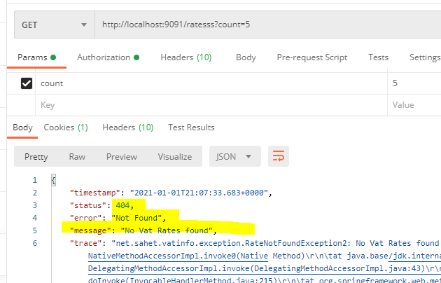
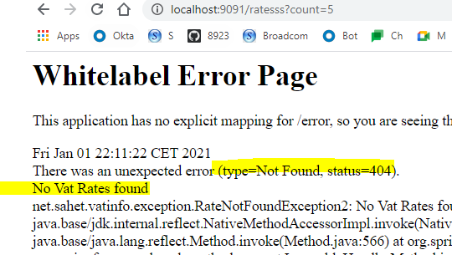
Mapping exceptions to HTTP status codes
/** An exception can be annotated with @ ResponseStatus
to map it to an HTTP status code*/
The HTTP status code of 404 is precisely the appropriate response status code when a resource isn’t found. So, let’s use @ResponseStatus to map RateNotFoundException to HTTP status code 404
@ResponseStatus(value = HttpStatus.NOT_FOUND, reason = "No Vat Rates found")
public class RateNotFoundException2 extends RuntimeException {
public RateNotFoundException2(String msg) {
super(msg);
}
Notes:
If the spittle() method is called on to handle a request, and the given ID comes up
empty, the SpittleNotFoundException will (by default) result in a response with a
500 (Internal Server Error) status code. In fact, in the event of any exception that isn’t
otherwise mapped, the response will always have a 500 status code. But you can
change that by mapping SpittleNotFoundException otherwise.
When SpittleNotFoundException is thrown, it’s a situation where a requested
resource isn’t found. The HTTP status code of 404 is precisely the appropriate
response status code when a resource isn’t found. So, let’s use @ResponseStatus to
map SpittleNotFoundException to HTTP status code 404.

Slide 11
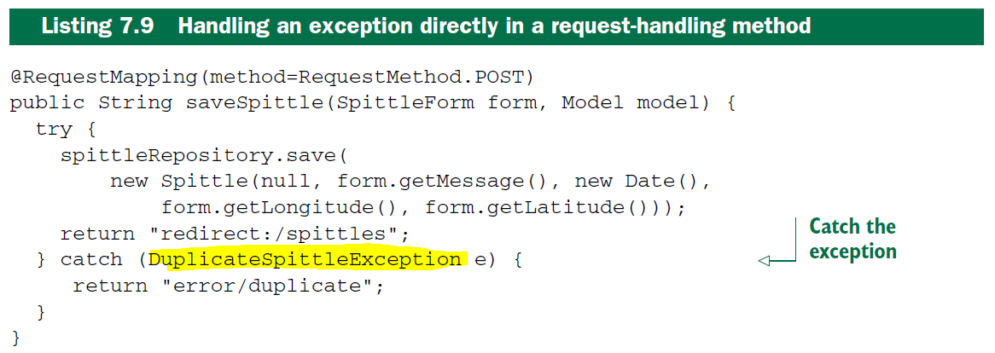
Writing exception-handling methods
Mapping exceptions to status codes is simple and sufficient for many cases. But what if you want the response to carry more than just a status code that represents the error that occurred?
Rather than treat the exception generically as some HTTP error, maybe you’d like to handle the exception the same way you might handle the request itself ??? E.g. create user with existing ID and save.. duplication ex. ..
Here it works fine, just only adds a bit complexity. As we see two paths (happy[success] and negative case[fail]), each with a different outcome.
BUT, much BETTER approach is, your method should focus only on HAPPY scenario and let the SPRING take care of negative cases (Exception Handling) for you.
Notes:
Writing exception-handling methods
Mapping exceptions to status codes is simple and sufficient for many cases. But what if
you want the response to carry more than just a status code that represents the error
that occurred?
But what if you want the response to carry more than just a status code that represents the error
that occurred? Rather than treat the exception generically as some HTTP error, maybe
you’d like to handle the exception the same way you might handle the request itself.
We usually write code in an idealized environment: the filesystem always contains our files, the network is healthy, and the JVM always has enough memory. Sometimes we call this the “happy path”.

Slide 12
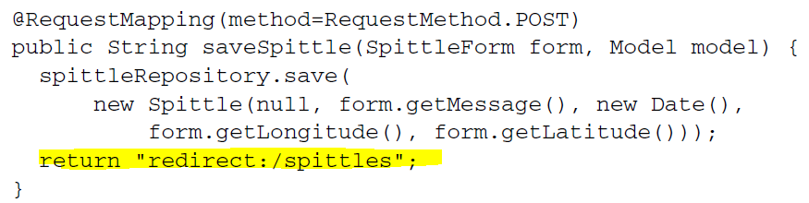
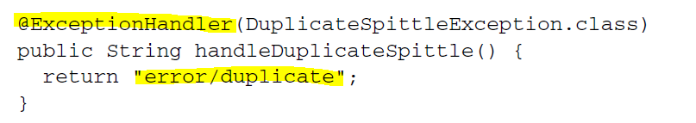
Writing exception-handling methods
Let’s divide code into happy scenario (much simpler) and exception-handling code, both contains only one path ☺
//methods annotated with @ExceptionHandler will handle a DuplicateSpittleException thrown from any method in same controller
Perfect, so negative-scenario can be even re-used by other methods.
If @ExceptionHandler methods can handle exceptions thrown from any handler is it possible to make it global?
Which means, simply handle exceptions thrown from handler methods in any controller.
Notes:
Rather than duplicate exception-handling code in every method that has the potential for throwing a DuplicateSpittleException, this
one method covers them all. exception-handling code out of saveSpittle():

Slide 13
Advising controllers
Certain aspects of controller classes might be handier if they could be applied broadly across all controllers in an app. One option to avoid code duplication is use base Controller class to keep @ExceptonHandler methods.
BUT there is more elegant option which Spring introduces. A controller advice is any class that’s annotated with @ControllerAdvice and has one or more of the following kinds of methods:
@ExceptionHandler-annotated (1) , @InitBinder-annotated, @ModelAttribute-annotated
Those methods in an @ControllerAdvice-annotated class are applied globally across all (1) annotated methods on all controllers in an application. One of the most practical uses is to gather all @ExceptionHandler methods in a single class so that exceptions from all controllers are handled consistently in one place.
@ControllerAdvice
public class VatRateExceptionAdwise {
@ExceptionHandler(value = VatRateNotFoundException.class)
public ResponseEntity<Object> exception(VatRateNotFoundException exception) {
return new ResponseEntity<>("VatRate not found", HttpStatus.NOT_FOUND);
}
@ExceptionHandler(value = DuplicateRateException.class)
public ResponseEntity<Object> exception2(DuplicateRateException exception) {
return new ResponseEntity<>("Rate Duplication", HttpStatus.CONFLICT);
}
}
Notes:
https://www.baeldung.com/spring-mvc-and-the-modelattribute-annotation
Advising controllers
Certain aspects of controller classes might be handier if they could be applied broadly
across all controllers in a given application. @ExceptionHandler methods, for
instance, could prove useful in handling exceptions across multiple controllers. If a
particular exception is thrown from multiple controller classes, you might find yourself
duplicating the same @ExceptionHandler method in all of those controllers. Or,
to avoid the duplication, you might create a base controller class that all of your controllers
could extend to inherit the common @ExceptionHandler method.
Spring 3.2 brings another option to the table: controller advice. A controller advice is
any class that’s annotated with @ControllerAdvice and has one or more of the following
kinds of methods:
○ @ExceptionHandler-annotated
○ @InitBinder-annotated
○ @ModelAttribute-annotated
Those methods in an @ControllerAdvice-annotated class are applied globally across all @RequestMapping-annotated methods on all controllers in an application.
The @ControllerAdvice annotation is itself annotated with @Component. Therefore,
an @ControllerAdvice-annotated class will be picked up by component-scanning, just like an @Controller-annotated class.

Slide 14
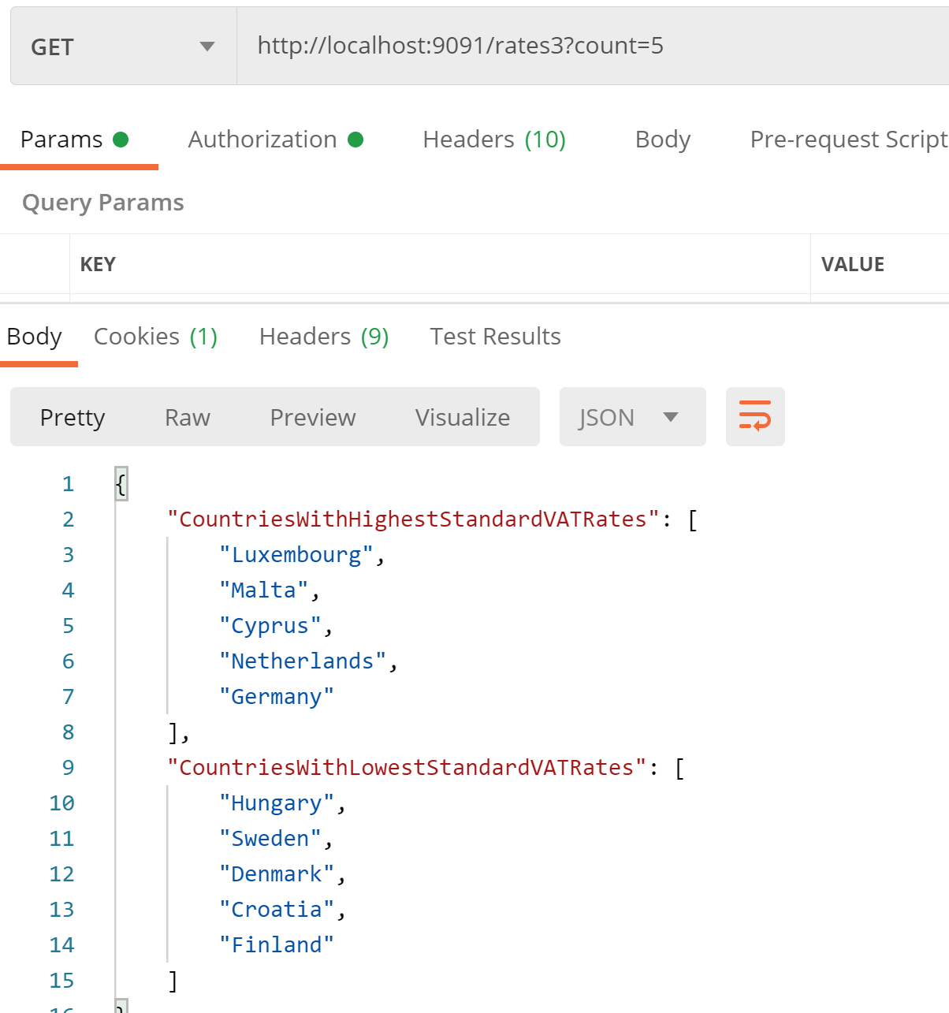
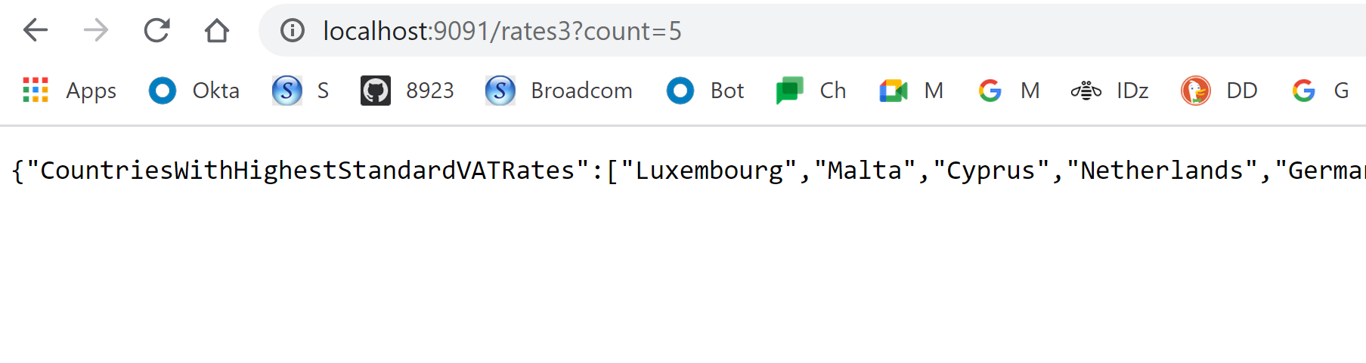
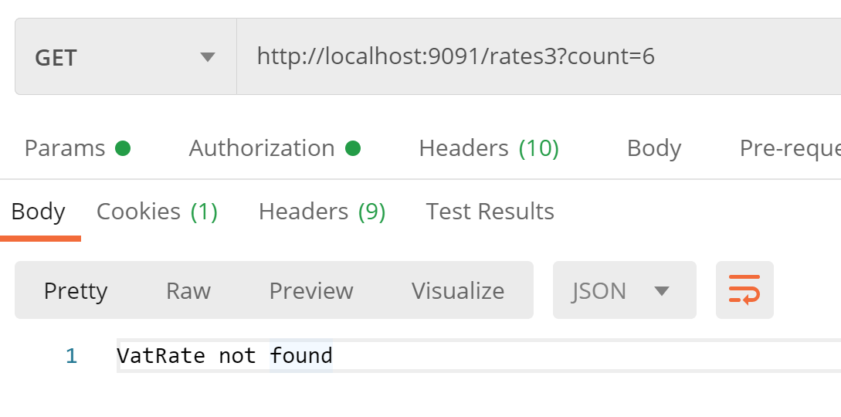
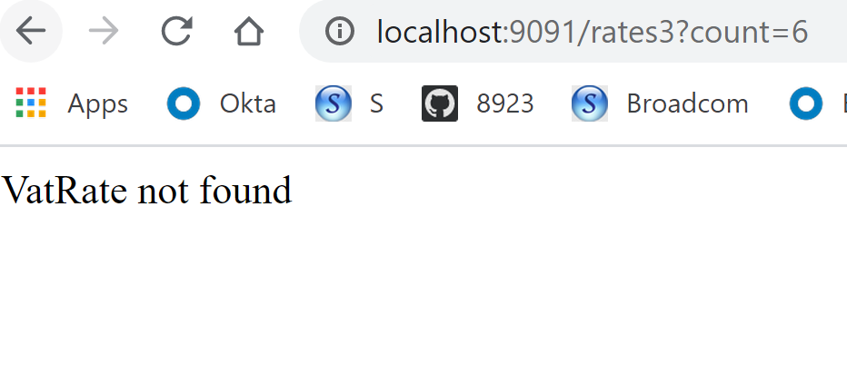
Advising controllers
Both HAPPY and FAIL (VatRate not found) scenarios are with pretty OBJECT form ☺

Slide 15
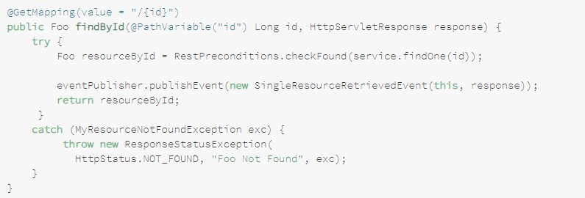
Spring 5 and above
Spring 5 introduces the ResponseStatusException class — a fast way for basic error handling in our REST APIs.
+ Excellent for prototyping: We can implement a basic solution quite fast.
+ One type, multiple status codes: One exception type can lead to multiple different responses.
+ We won't have to create as many custom exception classes, exceptions can be created programmatically.
There's no unified way of exception handling: as opposed to @ControllerAdvice, which provides a global approach.
Code duplication: We may find ourselves replicating code in multiple controllers.
Notes:
https://www.baeldung.com/exception-handling-for-rest-with-spring

Slide 16
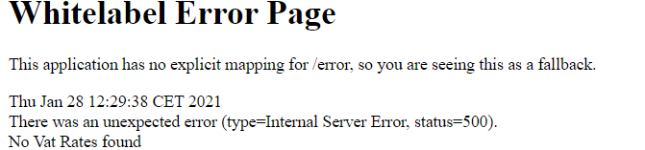
Spring Boot Support
A fallback error page for browsers (a.k.a. the Whitelabel Error Page) and a JSON response for RESTful, non-HTML requests:
As usual, Spring Boot allows configuring these features with properties:
server.error.whitelabel.enabled: can be used to disable the Whitelabel Error Page and rely on the servlet container to provide an HTML error message
server.error.include-stacktrace: with an always value; includes the stacktrace in both the HTML and the JSON default response
Apart from these properties, we can provide our own view-resolver mapping for /error, overriding the Whitelabel Page.
@Component public class MyCustomErrorAttributes extends DefaultErrorAttributes { @Override public Map<String, Object> getErrorAttributes(
…
@Component public class MyErrorController extends BasicErrorController { public MyErrorController(ErrorAttributes errorAttributes) { super(errorAttributes, new ErrorProperties()); }
Notes:
https://www.baeldung.com/exception-handling-for-rest-with-spring

Slide 17

THANK YOU
References
https://github.com/azatsatklichov/vatinfo
https://www.manning.com/books/spring-in-action-fourth-edition
https://developer.mozilla.org/en-US/docs/Web/HTTP/Methods
https://spring.io/blog/2013/11/01/exception-handling-in-spring-mvc
https://www.baeldung.com/exception-handling-for-rest-with-spring
Notes:
https://developer.mozilla.org/en-US/docs/Web/HTTP/Caching

